Slide 1
BANK CUSTOMER CHURN PREDICTION
Presented By
1. Pranav Wani
2. Shubham kalsekar
3. Manish Patil
4. Anuj Deshmukh
Guided By
Ms Ashwini Kakde

Slide 2
OUTLINE
Problem Statement
Data Dictionary
About Dataset
Preprocessing steps used
ML Algorithm Used
1. SVM
2. Logistic Regression
3. Random Forest
4. Decision Tree
5. XGBoost
6. KNN
Model Evaluation
Conclusion

Slide 3
PROBLEM STATEMENT
Given the details of a bank's customers and the target variable is a binary variable reflecting the fact whether the customer left the bank (closed his account) or he continues to be a customer, by creating best ML model

Slide 4
DATA DICTIONARY DATASET USED = churn_modeling.csv
Feature Name | Data Type | Description
RowNumber | Integer | Corresponds to the record (row) number
CustomerId | Integer | Bank Customer ID
Surname | Object | Bank customer surname
CreditScore | Integer | Credit score of customer
Geography | Object | Location/country of customer
Gender | Object | Gender of customer
Age | Integer | Age of bank customer
Tenure | Integer | Refers to the number of years that the customer has been a client of the bank.
Balance | Float | Customer bank balance

Slide 5
DATA DICTIONARY DATASET USED = churn_modeling.csv
Feature Name | Data Type | Description
NumOfProducts | Integer | Refers to the number of products that a customer has purchased through the bank.
HasCrCard | Integer | Denotes whether or not a customer has a credit card.
IsActiveMember | Integer | active customers
EstimatedSalary | Float | Estimated Salary customer
Exited | Integer | whether or not the customer left the bank.

Slide 6
ABOUT DATASET
Dimension of Dataset : (10000,14)
Name of Column :
'RowNumber', 'CustomerId', 'Surname', 'CreditScore', 'Geography', 'Gender', 'Age', 'Tenure', 'Balance', 'NumOfProducts', 'HasCrCard', 'IsActiveMember', 'EstimatedSalary', 'Exited’
Is there any missing values? No
No. of Categorical columns - 3

Slide 7
PRE-PROCESSING STEPS PERFORMED
Input X : { 'CreditScore', 'Geography', 'Gender', 'Age', 'Tenure', 'Balance', 'NumOfProducts', 'HasCrCard', 'IsActiveMember', 'EstimatedSalary’ }
Output y : {Exited}
Convert Categorical Columns into Numerical
Gender : Using Label encoder
Geography : Using One Hot Encoder
Standardize data using Min Max Scaler
Balance the dataset using SMOTE
Splitted data into Training and Testing Using test_size = 20%

Slide 8
ML ALGORITHMS USED
As the Output feature of my Dataset is Categorical hence we are performing Classification on the dataset
We have decided to use following six algorithms for classification
1. SVM
2. Logistic Regression
3. Random Forest
4. Decision Tree
5. XGBoost
6. KNN

Slide 9
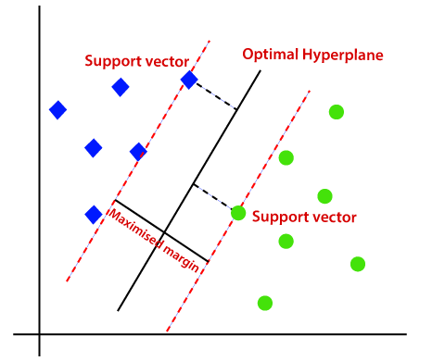
1. SUPPORT VECTOR MACHINE (SVM)
Best Estimator:
{'C': 57, 'gamma': 1, 'kernel': 'rbf’}
Jaccard Score: 0.7235817575083426
F1 Score: 0.8438886143160222
Accuracy Score: 0.8440050219711237

Slide 10
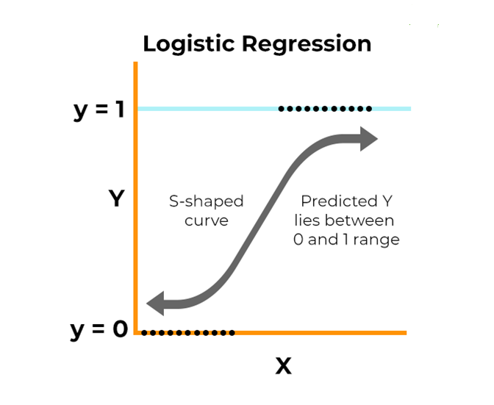
2. LOGISTIC REGRESSION
Best Estimator:
{'C': 1000.0, 'penalty': 'l1', 'solver': 'liblinear'}
Jaccard Score: 0.5442918048318333
F1 Score: 0.6978910057249199
Accuracy Score: 0.6980539861895794

Slide 11
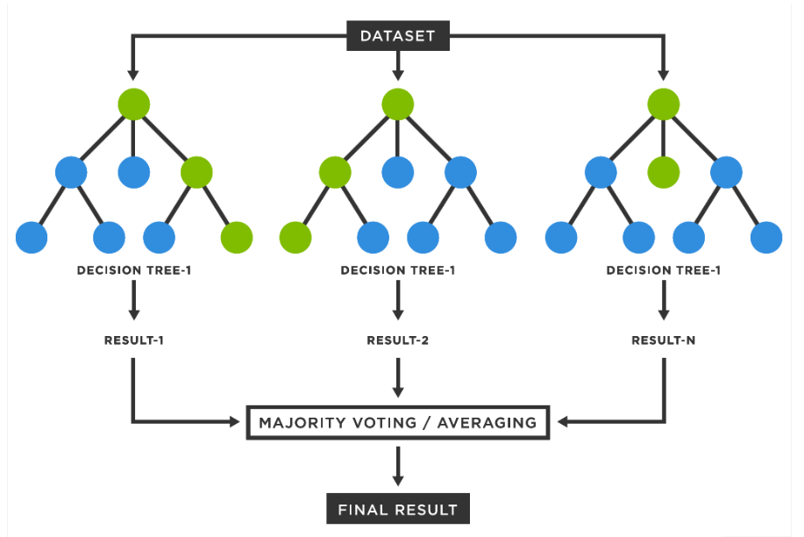
3. RANDOM FOREST
Best Estimator:
{'max_depth': 20, 'min_samples_leaf': 5, 'n_estimators': 100}
Jaccard Score: 0.780829596412556
F1 Score: 0.8772746013379615
Accuracy Score: 0.8772755806654112

Slide 12
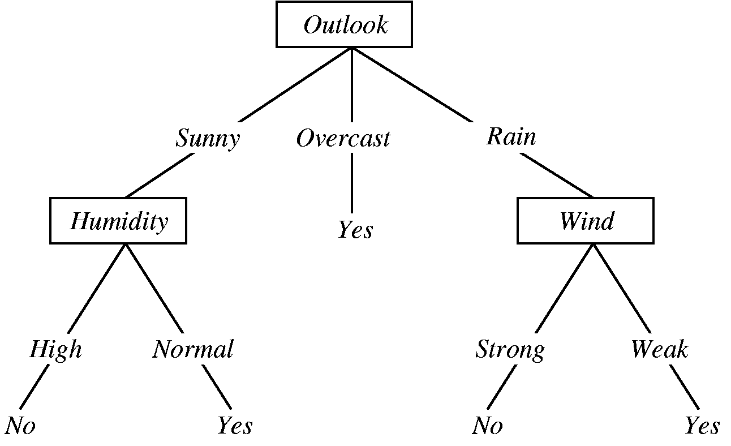
4. DECISION TREE
Best Estimator:
{'ccp_alpha': 0.001, 'criterion': 'entropy', 'max_depth': 8, 'max_features’:
'auto'}
Jaccard Score: 0.6561203319502075
F1 Score: 0.7919010670065366
Accuracy Score: 0.7919020715630886

Slide 13
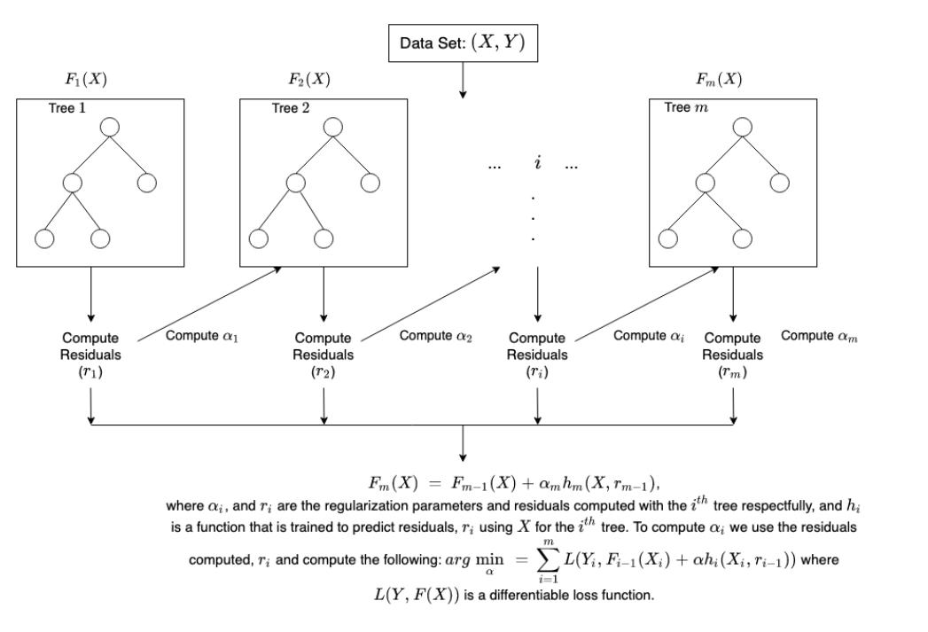
5. XGBoost
Best Estimator:
{'xgbclassifier__gamma': 0.5, 'xgbclassifier__max_depth': 3,
'xgbclassifier__n_estimators': 50}
Jaccard Score: 0.8264508928571429
F1 Score: 0.9023125936665654
Accuracy Score: 0.9023854362837413

Slide 14
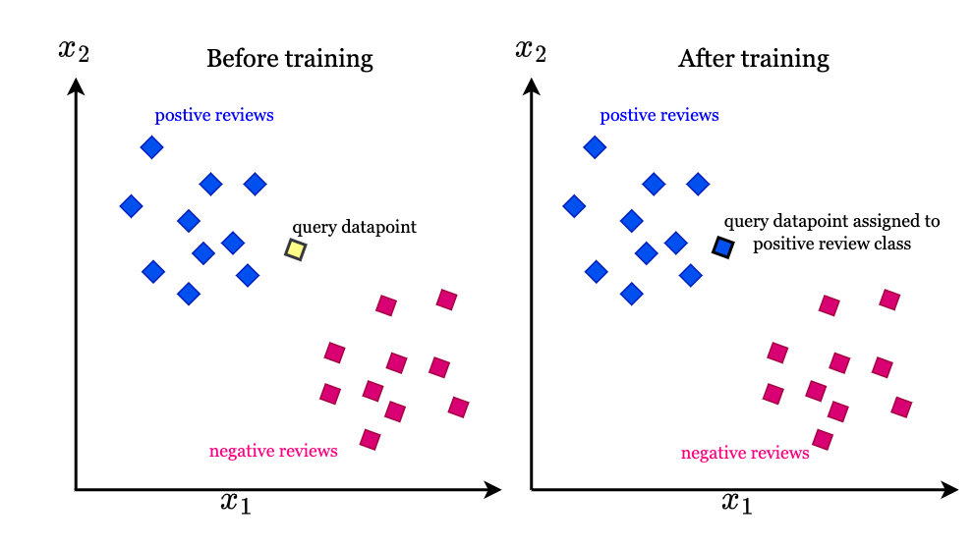
6. KNN
Best Estimator:
{'algorithm': 'auto', 'n_neighbors': 3 , 'weights': uniform}
Jaccard Score: 0.7906836055656382
F1 Score: 0.8908506542885207
Accuracy Score: 0.8913998744507219

Slide 15
MODEL EVALUATION

Slide 16
1. USING COMPARATIVE TABLE
Metrics | SVM | Logistic Regression | Random Forest | Decision Tree | XGBoost | KNN
Jaccard Score | 0.723582 | 0.543303 | 0.780830 | 0.656120 | 0.826451 | 0.790684
F1 score | 0.843889 | 0.696944 | 0.877275 | 0.791901 | 0.902313 | 0.890851
Accuracy | 0.844005 | 0.697112 | 0.877276 | 0.791902 | 0.902385 | 0.891400
From Above table XGBoost and KNN gives here good accuracy

Slide 17
2. USING K-FOLD CROSS VALIDATION
Model | Cross_val_score
SVC | 0.8383045525902668
LogisticRegression | 0.71287284144427
RandomForestClassifier | 0.8684458398744113
DecisionTreeClassifier | 0.7725274725274726
XGBClassifier | 0.8974097331240187
KNeighborsClassifier | 0.8845368916797488

Slide 18
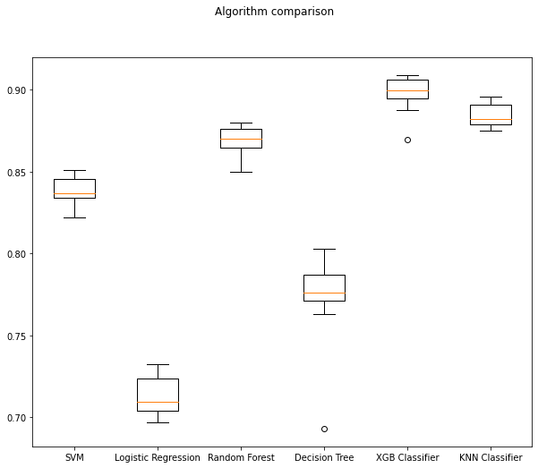
K-fold Cross Validation

Slide 19
3. Using ROC_AUC Curve
Model | AUC
SVC | 0.913825
LogisticRegression | 0.778052
RandomForestClassifier | 0.946472
DecisionTreeClassifier | 0.861601
XGBClassifier | 0.962703
KNeighborsClassifier | 0.891400

Slide 20
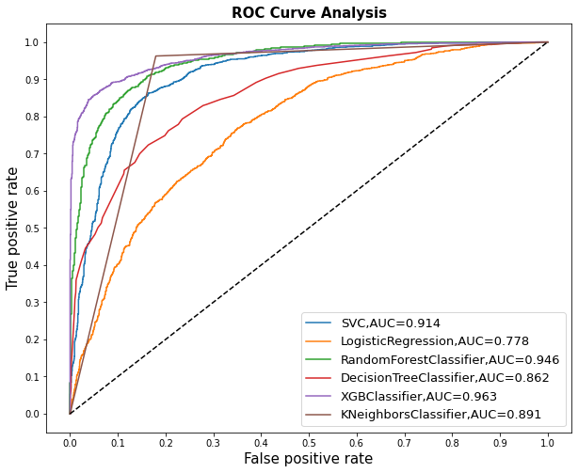
ROC AUC Curve

Slide 21
Conclusion
XGBoost is out performing other model Hence it is best model for my dataset

